Slide 1








Shanthi Family Care Hospital Management System
Final Viva Presentation
KADSE24.2F-001 Madusha Rajapaksha
KADSE24.2F-009 Heshan Bandara
KADSE24.2F-025 C.M.B Bandara
KADSE24.2F-047 H.M.N.K Kumara

Slide 2







Project Overview
Mission
Goals
Achievement
✅ Derive operational efficiency
✅ Assist in decision-making processes
✅ Provide comprehensive MIS and Analytics
✅ Streamline healthcare workflows
Awarded as Top Hospital Management System
In Palllepola with a good laboratory Management System. Co-Workers are present to issue the stocks and bills manually
Integrates all the HIS Systems, Processes, and machines into an intelligent information system

Slide 3

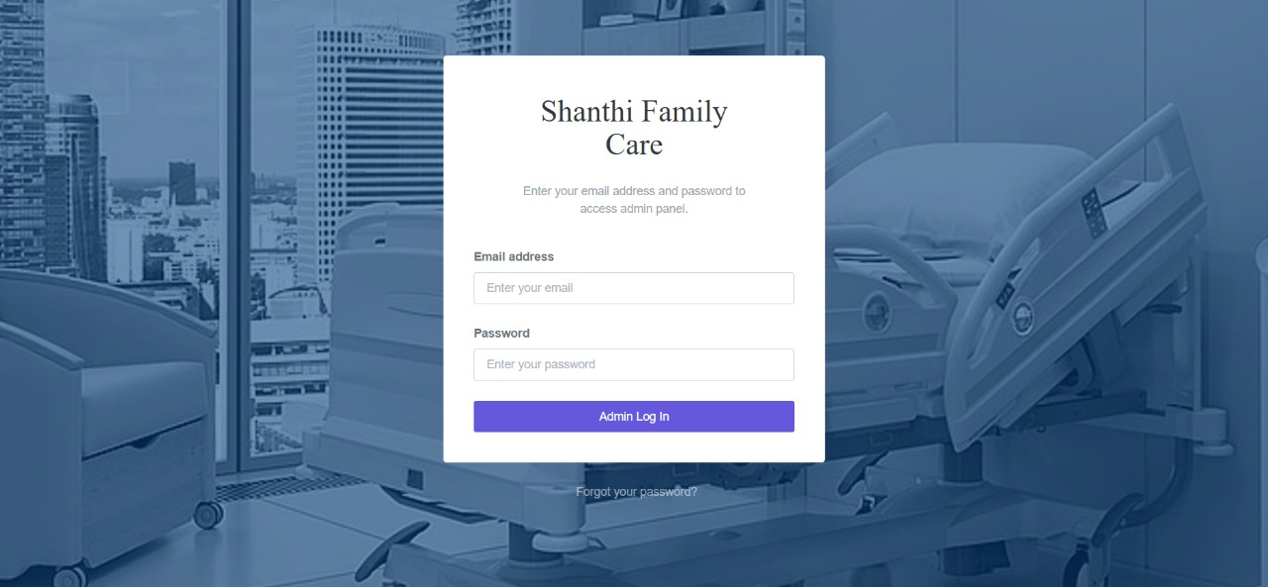
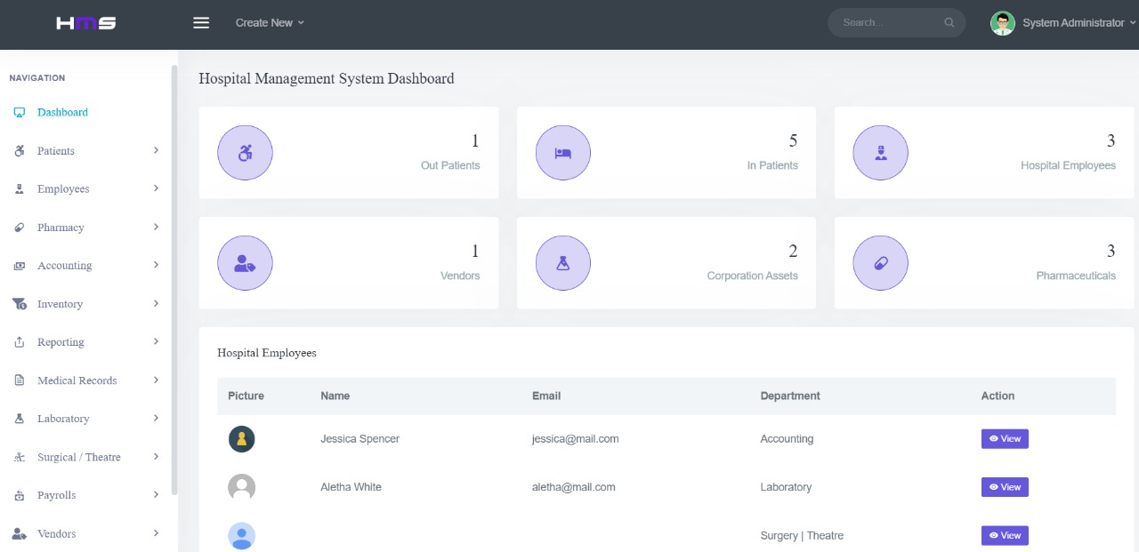
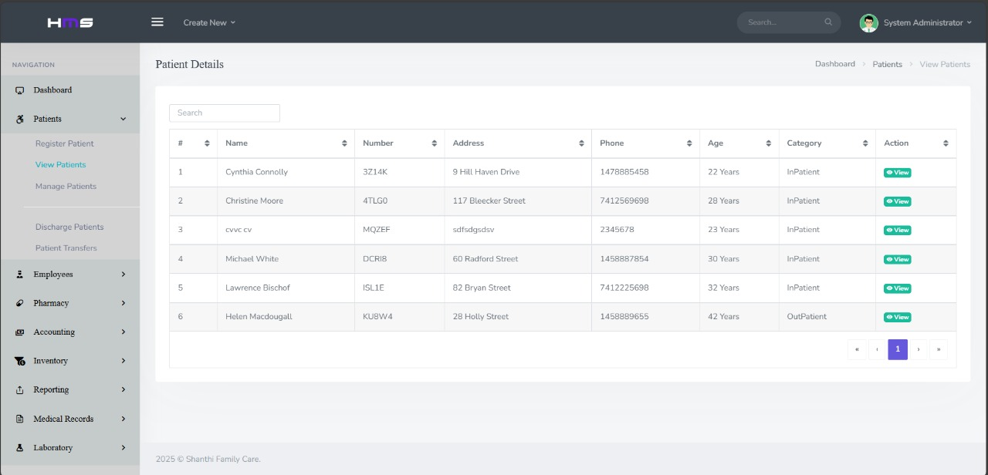
System Architecture
01
02
03
FRONTEND LAYER
• Bootstrap 4.1.3
• jQuery & JavaScript
• Responsive Design
BACKEND LAYER
• PHP 5.6+ Server Logic
• Session Management
• Security Authentication
DATABASE LAYER
• MySQL Database
• Normalized Structure
• Data Integrity

Slide 4








Key Features
🔐 Multi-User Authentication
Secure login with encrypted passwords
- Role-based access control
👥 Dual Interface System
Administrator Panel - Full system control
- Doctor Panel- Clinical workflow
📊 Real-time Dashboard
System overview & KPIs
- Quick access to functions
🏥 Complete Patient Management
Registration to discharge
Medical history tracking

Slide 5
Technical Stack Tools
01
02
03
Frontend Technologies
HTML5 - Semantic structure
CSS3 - Modern styling
Bootstrap 4.1.3 - Responsive framework
jQuery 2.2.4 - JavaScript functionality
Font Awesome - Icon library
Backend Technologies
PHP 5.6+ - Server-side logic
MySQL - Database management
Apache - Web server
Additional Features
OWL Carousel - Content sliders
WOW.js – Animations
Date Time Picker - Date selection

Slide 6



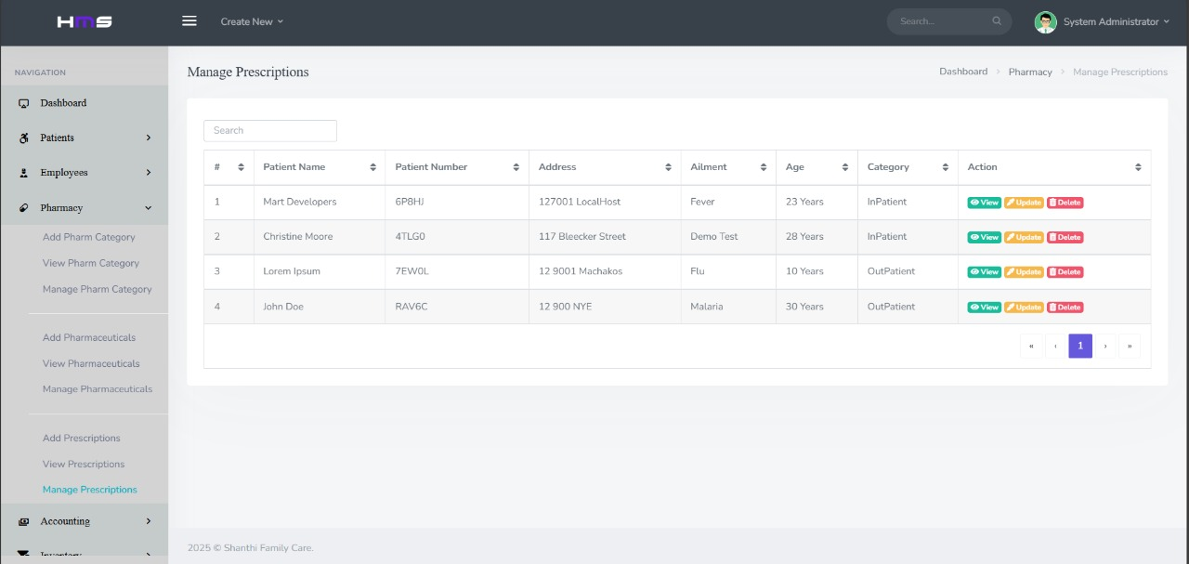
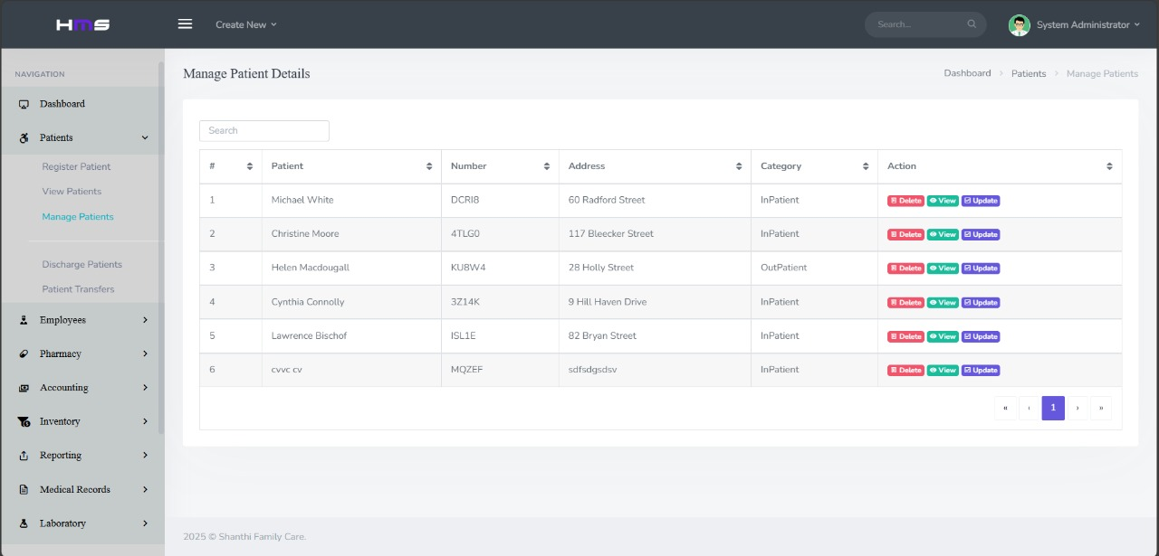

Patient
Interfaces
Prescription

Slide 7




01
About us
Located in the heart of Pallepola, Akurana, Shanthi Family Care Medical Center is a trusted name in community healthcare. We are committed to delivering compassionate, high-quality medical services tailored to the needs of families in our region.
With a focus on modernizing healthcare delivery, our center integrates traditional care values with cutting-edge technology. Our newly implemented Hospital Management System ensures seamless coordination across departments—from patient registration and diagnostics to pharmacy and billing—enhancing both efficiency and patient satisfaction.

Slide 8
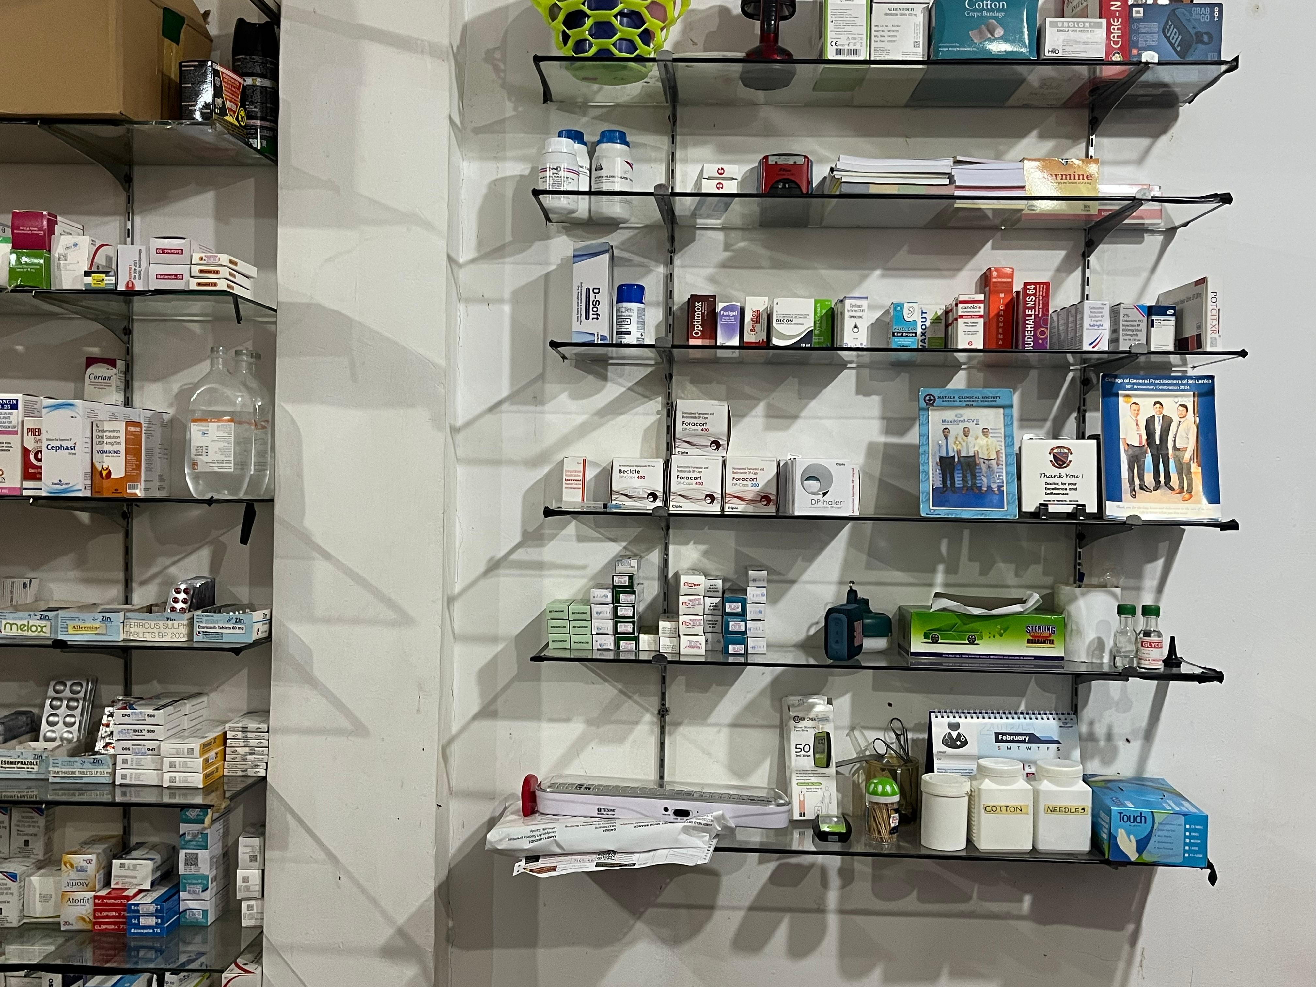
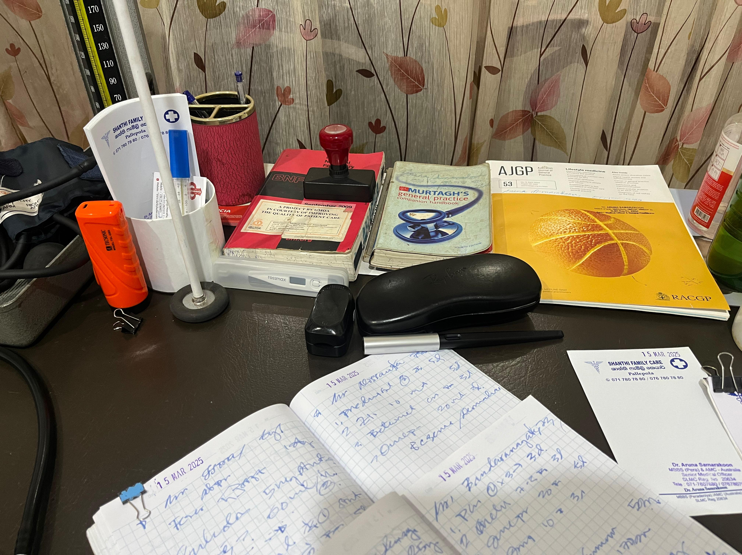
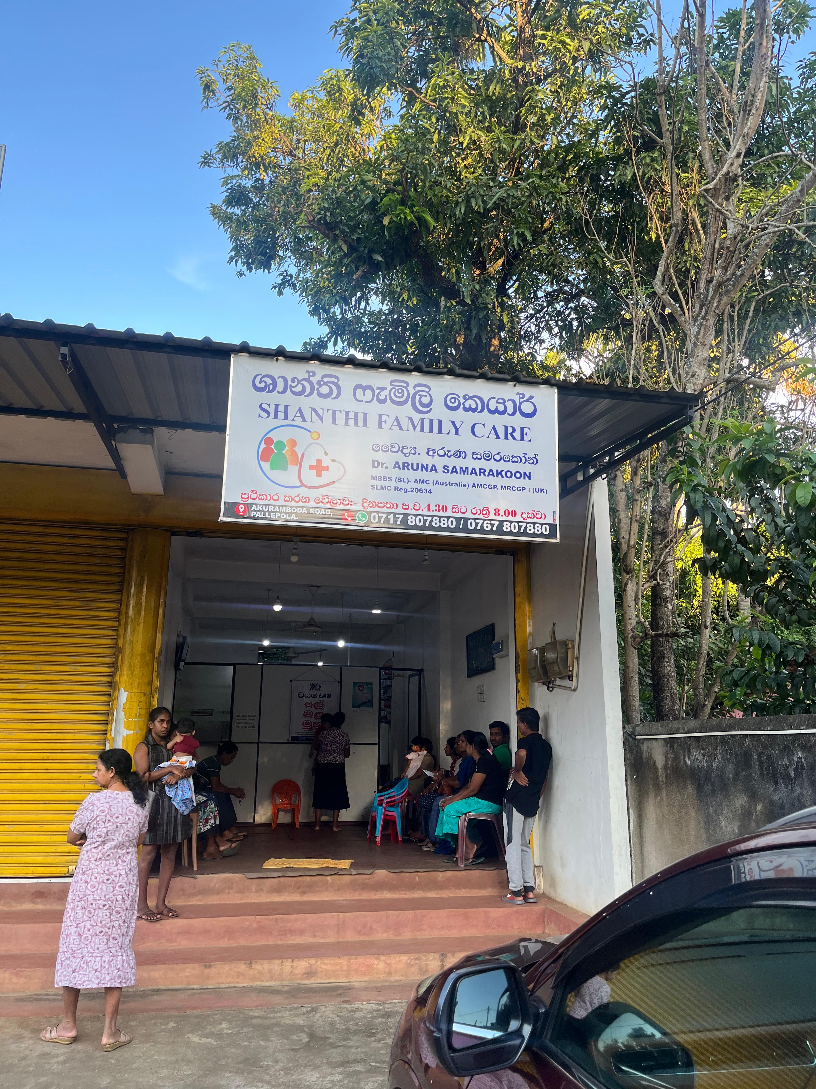
Services
Laboratory System
On-time Medical Prescriptions
Geographical Location
Medical Checkups like E.C.G, Routine Blood Tests (CBC, lipid profile, glucose levels) are provided.
Patients can reach to the destination much easily
Pharmaceuticals can be retrieved with the Patient Bio-Report.

Slide 9


Results & Impact
Service One
Service Two
Enables doctors to create, view, and manage prescriptions.
Allows registration, profile updates, and appointment scheduling.
Service Three
Service Four
Displays and print medical history, lab reports, and billing info .
Links with patient history and lab results.

Slide 10


Database Design
`Dbs_admin` - Administrator accounts
`Dbs_docs` - Doctor profiles
`Dbs_patients` - Patient records
`Dbs_pharmaceuticals` - Drug inventory
`Dbs_lab_tests` - Laboratory data
`Dbs_prescriptions` - Medication orders
`Dbs_accounts` - Financial records
`Dbs_assets` - Equipment inventory
Database Features
Normalized structure
✅ Foreign key relationships
✅ Indexed performance
✅ Encrypted sensitive data
✅ Backup support

Slide 11

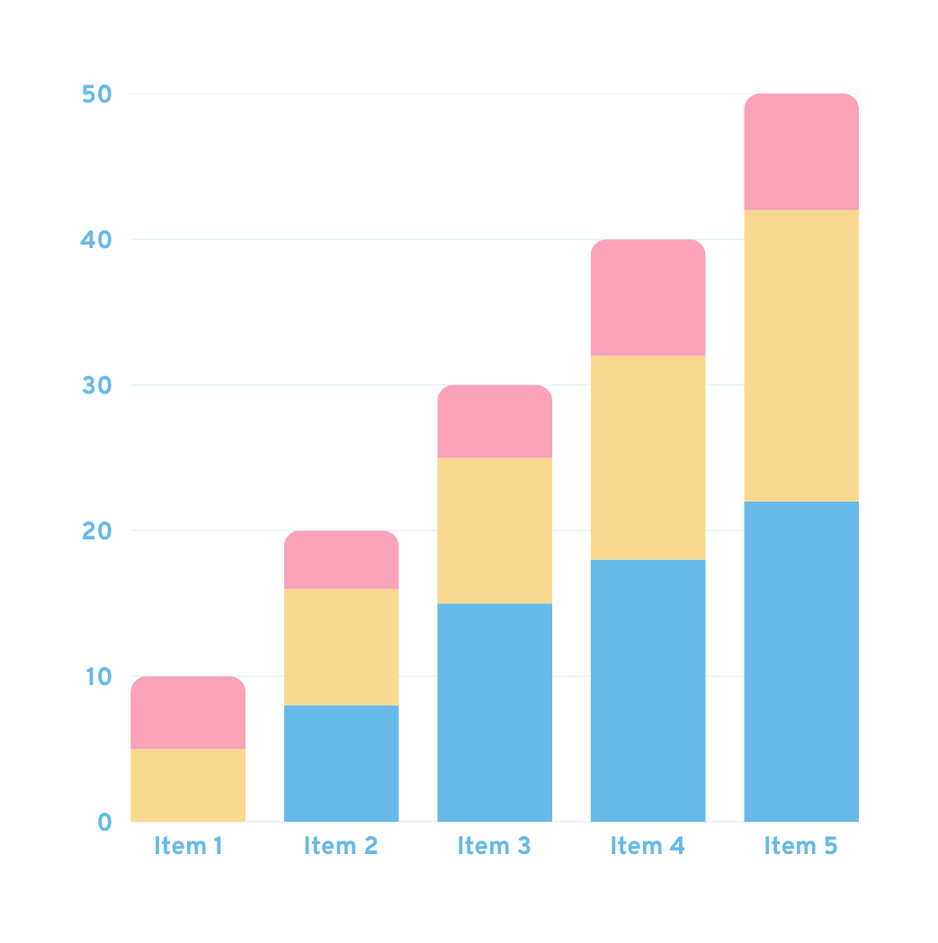

System Benifits
For Health-Care Providers.
📈 Improved Efficiency- Streamlined workflows
📊 Better Decisions - Real-time data access
💰 Cost Reduction - Automated processes
📋 Compliance - Regulatory adherence
🔍 Quality Care- Comprehensive tracking

Slide 12






Implementation Timeline
Phase 1 : Foundation
Phase 2 : Core Modules
Phase 3 : Advanced Features
Phase 4 : Go Live
Week 1-4
Week 5-8
Week 9-12
Week 13-16
System setup and configuration
Database installation and setup
Basic user training
Patient management implementation
Pharmacy system deployment
Laboratory integration
Financial module activation
Reporting system setup
Full system testing
.
Production deployment
Staff training completion
Support transition
.

Slide 13

S
W
STRENGTHS
WEAKNESSES
Centralized Inventory
Web-based system for medical supplies.
Secure Billing
Accessible system for patient services.
Handwritten records, notebooks, paper receipts.
Time-consuming patient interactions.
O
T
OPPORTUNITIES
THREATS
Enhanced Security
Role-based access, HTTPS encryption.
Increased human error likelihood.
Difficulty retrieving historical data.

Slide 14








Thank you!
We welcome your Feedback and Suggestions.
Contact Us
Akurana Road, Pallepola
0717 807880/ 0767 807880
hello@Shanthifam_Care.com
@ShanthifamilyCare
ShanthifamilyCare.com

